Slide 1
Parking Analytics in a Smart City
By Poornima Ramachandran

Slide 2
INTRODUCTION
1.What is a Smart City ?
2. Parking Analytics
3. Need for a Systematic Parking Analytics system
4. State of Art – Work done so far
5. System Architecture
6. Proposed Model
7. Conclusion

Slide 3
What is a Smart City ?
A Smart City is an Urban Development vision to integrate multiple information and communication technology in a secured fashion to make the city assets that includes but not limited local departments information systems like schools , libraries , transport , traffic management , entertainment etc to function in a well defined manner which is the constantly monitored.

Slide 4
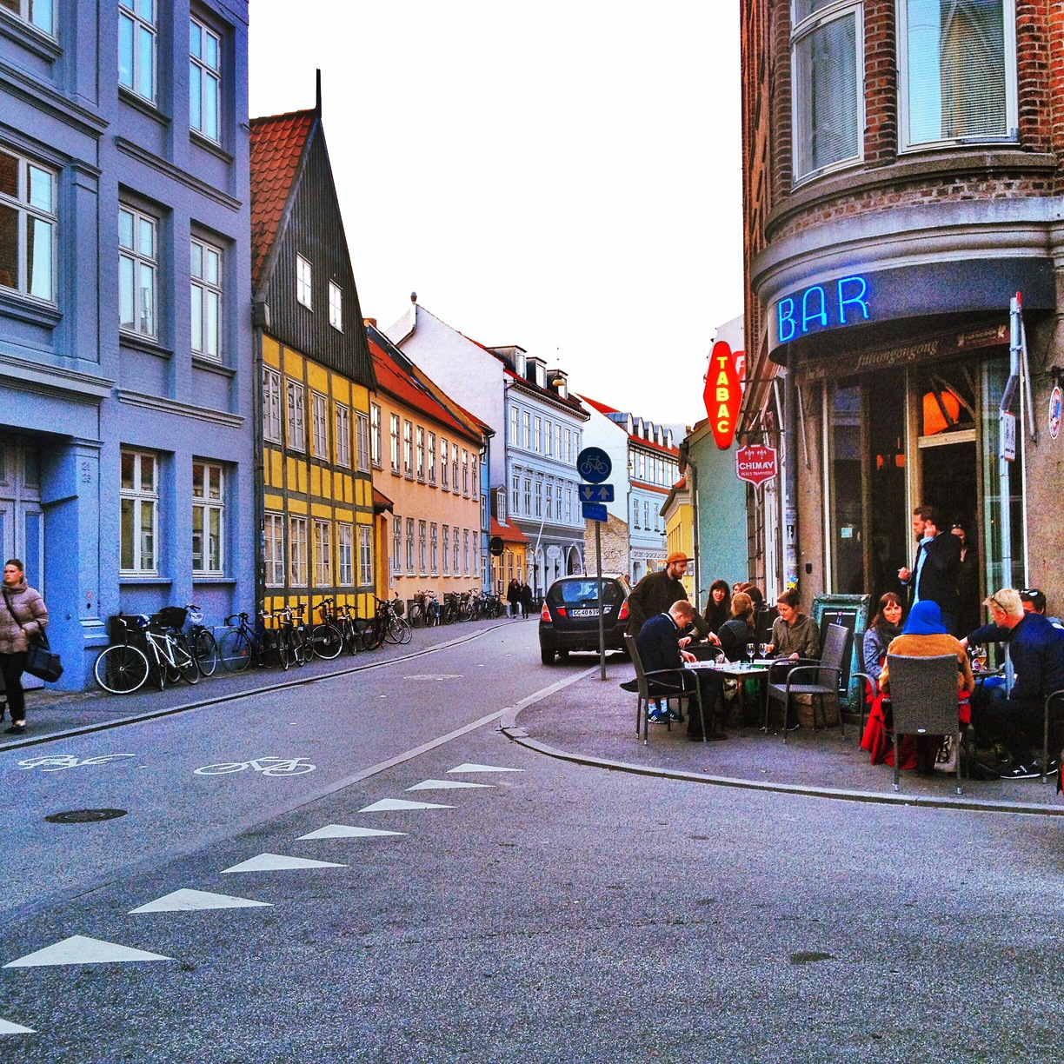
Example For a Smart City -Aarhus , This is a city in Denmark.

Slide 5
Parking Analytics
With the increase in the economic behavior and the upgrade of living standards of citizens across the world. The ratio of people who own automobiles have increased drastically .
This has caused an shortage of parking spots which has indirectly increased the traffic congestion and air pollution in the cities across the world
A well defined system for parking will always be helpful in ensuring a proper flow of traffic and parking management.

Slide 6
Need for a Systematic Parking Analytics system
Parking is the third biggest revenue generating sector in a city.
Search for Parking contributes 40 percent of the traffic congestion.
A well defined parking analytics system will help us understand the parking behaviors of citizens in general.
Regularize the parking tickets prices.
We the traffic administration will be able to resolved the citizens request and complaints in a quick and transparent manner.
A systematic parking analytics system will also help in reducing the air population.

Slide 7
State of Art- The Work done so Far
There a number of research and systems which were designed to build an efficient parking system. The notable systems are
1.Blind Search
2. Parking Information system
3. Buffer Parking Information Systems.

Slide 8
Blind Search Technique
Blind Search Technique is a simple search strategy applied by users when there is no parking information available.
In this technique the drivers search for an empty spot and driver around till their get an empty parking spot .

Slide 9
Parking Information System
Mechanism which is commonly adopted by the current parking analytics systems.
This system will scan through all the available parking spots in the areas .
Once the available parking spots are accounted for the system sends the information to all the drivers in the certain area.
The drivers can then decide which parking spot they can park.

Slide 10
Buffer Parking Information Systems
This is a modified version of Parking Information Systems.
In this version the system intentionally reduce the number of vacant parking spaces when publishing the live availability .
The remaining parking spots will be kept as a buffer.
So depending on the additional requirement the system will release those buffer spots and publish the data for available parking.

Slide 11
Performance Metrics of these Model
The performance metrics for the systems defined are
Walking Distance : This is the distance from the driver’s selected parking space to the destination where the drive needs to reach should be minimal.
Traffic Volume : With an effective parking systems we have we will reduced traffic congestion.

Slide 12
Drawbacks of this system
If the number of parking lot is very limited in busy hours it is likely that the available parking slots might not be enough for the numbers of vehicles that required parking in the specified area .
This will again bring us back to the blind search technique where the drivers will drive around in search of a free parking space.
Secondly it will also might be difficult to manage the parking arrangements as a number of drivers will be looking to park at the same spot .

Slide 13
Challenges of Parking Information Systems
1. Fake Parking Information Systems: The System collects and stores the data about the performance metrics specially the requests which are fake and can cause chaos and traffic congestion.
2. Delay In reaching the Parking Spot : Once the parking spot is reserved if the driver is not arrived in a stipulated time.
3. User Identification: To identify who has driver who needs the parking at that particular .
4.Timer : The amount of the time the driver needs the parking for

Slide 14
Reservation Parking Information System
To enhance the parking information systems the researchers have come up with something named Reserved parking systems.
This system generates the number of the available parking spots and the driver will be able to reserve their parking spots with the help of the Quick Response code (QR code).
Once the QR code is typed in the parking will be reserved for the driver with a buffer time limit in case of any delay due to traffic congestion , weather etc.

Slide 15
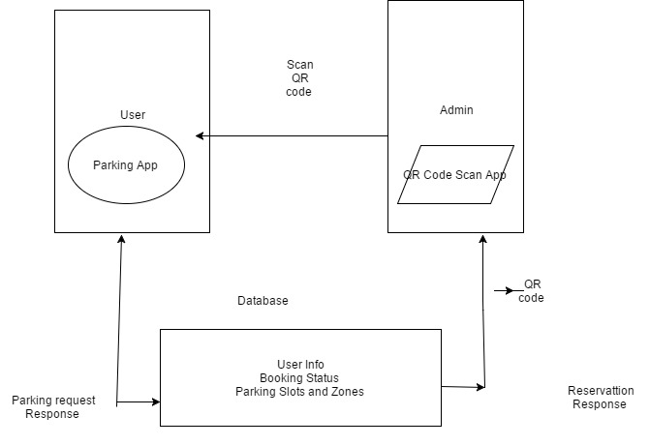
System Architecture

Slide 16
Our Contribution
As the cars of the roads cause 75 percent of the total air pollution.
As there is a lot of Importance given to the environment in todays day and age with the green house effect .
In the 75 percent of the air pollution , 40 percent is caused by the vehicles looking for parking.
Our systems will regular give regular updates to the administrations which will help them ensure enough infrastructure and measures are taken to control the air pollution.

Slide 17
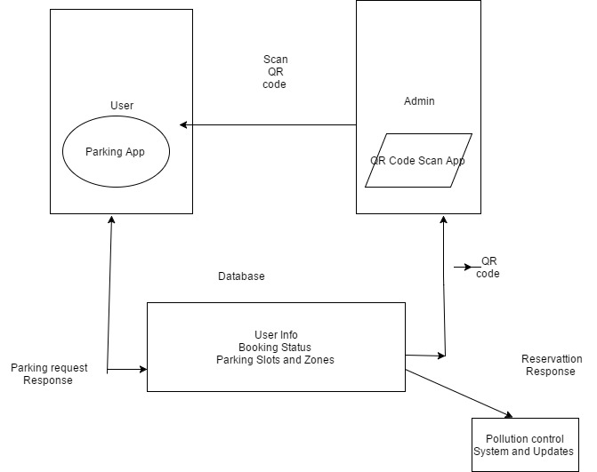
System Model

Slide 18
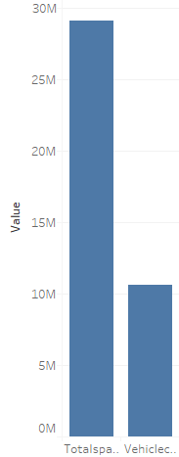
Analysis of Parking data in Aarhus City

Slide 19
Benefits of the Model
Understand the parking pattern of the citizens and build the city’s infrastructure accordingly.
Once we identify the congestion areas we can identify ways to solve the problem of parking
Better planning and infrastructure we can help in reducing the air pollution.

Slide 20
Future Scope
We can integrate these systems to Google Positioning Systems Which will help give the driver the short route to reach parking spot destinations

Slide 21
Reference Article
ieeexplore.ieee.org/iel5/5888675/5928760/05928901.pdf
Smart Parking Reservation System By Mohit Patil and Rahul Sakore

Slide 22
Thank you

